Slide 1

Notes:
Introduction
Warm up chatting; personal discussion as appropriate
Exciting times at Habitat - new strategic plan and comprehensive campaign
Connect back to how the donor was involved in the past, what they’ve heard before, etc.
Build Forward Together is all about doing more and doing better – you’ll see those two themes throughout

Slide 2
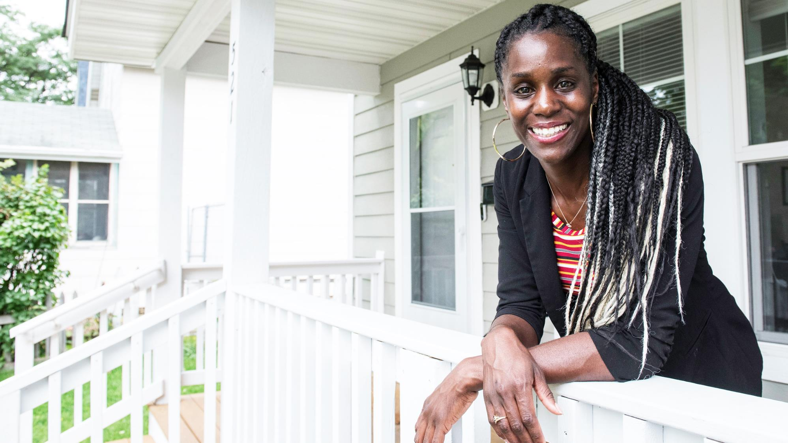
Overview of
Twin Cities Habitat
for Humanity
I want my kids to grow up and know they can go anywhere in this world, and they always have a home to return to. I feel like this is the beginning of that.
- LeAndra, Habitat Homeowner Since 2019
“
Notes:
Background
We’ll share background on the plan, how we got here, etc.
Pictured on this slide is LeAndra
Women Build house - 2019
Featured in Star Tribune, independent of Habitat, all about her backyard gardening
Other story – LeAndra could have her daughter’s sports team over; they were so proud to be able to host a big gathering like that

Slide 3




1,700+
Homeowner partners
About Twin Cities
Habitat for Humanity
2,000+
Home repair projects
Our mission
We bring people together to create, preserve, and promote affordable homeownership and advance racial equity in housing.
8,000+
Donors annually
15,000+
Volunteers annually
Notes:
New Mission statement
“Create, preserve, and promote homeownership” because we believe in the transformational power of home – homeownership is linked to healthier live, stronger education outcomes, a viable workforce, and generational wealth
“bring people together” is what sets us apart from just any housing developer – we bring together people from all walks of life
Advance racial equity – need to turn the tide on our racial gaps and build a more vibrant, equitable Twin Cities community
Twin Cities Habitat is a leader
Twin Cities Habitat for Humanity is the largest affordable homeownership builder in the seven-county metro area and is an innovative leader across Habitat for Humanity’s global network.
Since 1985, more than 1,600 families have unlocked the dream of homeownership with Twin Cities Habitat.
Thousands more have stabilized and improved their housing, finances, and quality of life through our programs.
We can’t do this work without the generous community of donors, volunteers, advocates, and partners
Volunteerism during covid – starts and stops; we relied heavily on regular crews to carry us through; we’re working back up to those pre-covid volunteer numbers
We also adjusted our volunteer totals; better experience with a smaller crew; used to be at 15-18 volunteers per site; shifting toward a cap of 12
Plenty of eagerness to get back building

Slide 4


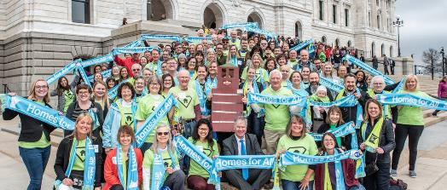
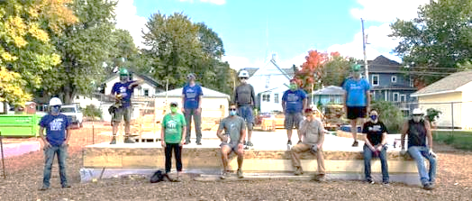

What we do
Homeownership Creation
Homeownership
Preservation
Advocacy
Global Engagement
ReStore Outlets
Notes:
What we do
Create Homeownership
Most people know Habitat for our Homeownership Program. Families partner with us to achieve stable, affordable homeownership. (More detail on following slides)
We also have programs to Preserve Homeownership – Home Repair Program, Mortgage Foreclosure Prevention, and Post-Purchase Mortgage Servicing and Homeownership Support
A Brush with Kindness remains an important part of our work
Advocacy – local, state, and federal
Want to ensure we have a seat at the table to promote affordable housing across the housing continuum
Local grassroots advocacy efforts are becoming even more important, as we push for some townhome projects/ higher density projects in our communities
Global engagement – financial commitment to Habitat affiliates around the globe; opportunities for local and global travel
We’re part of a global network of Habitat affiliates
Pre-covid, we supported through Global village trips – hopeful those will resume in late 2023
Even without the GV trips, we continue to support global engagement through the Global Impact Fund – fund affiliate partners directly; Haiti, Ethiopia, Nicaragua, Dominican Republic, Guatemala; also contribute to HFH global mission ‘greatest need fund’ – that’s how we contributed to HFH’s response in and around Ukraine
ReStore Home Improvement Outlets – social enterprise that generates funds for our mission; locations in Minneapolis and New Brighton with plans for a third location soon
Last strategic plan – added 2nd store
This plan – exploring a 3rd store

Slide 5
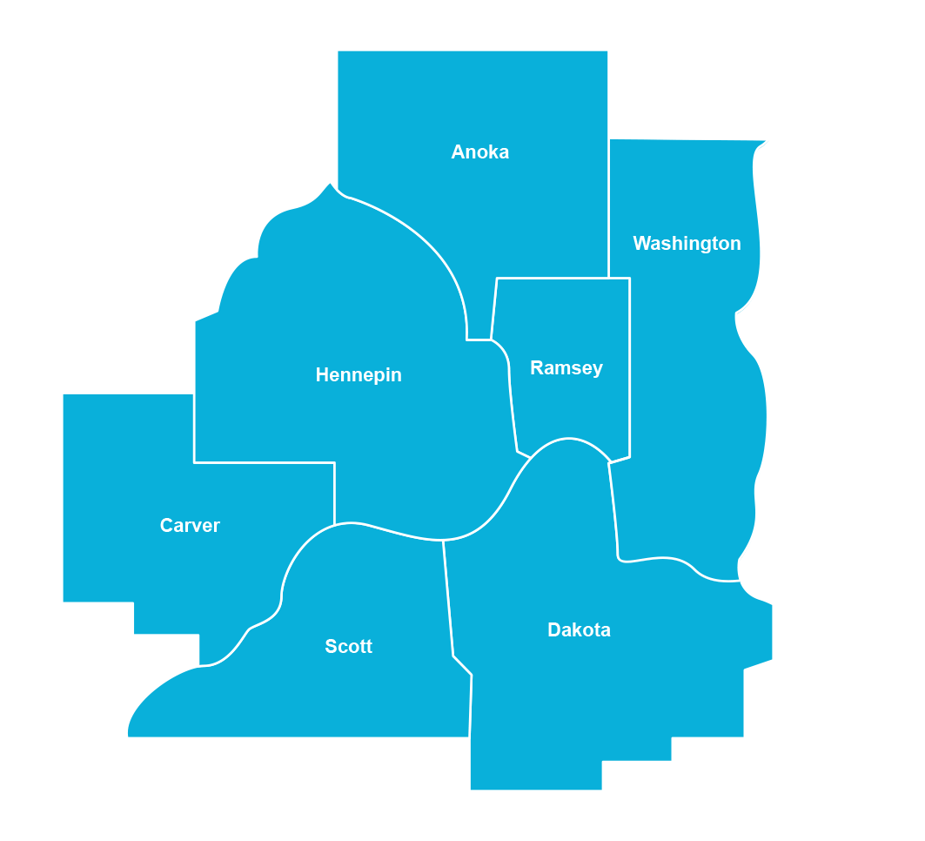
Home locations
Where we build
Since 1985 more than 1,700 families
have bought homes in 77 cities
across the 7-county metro area
Notes:
Many people think we just build homes in the core cities of Minneapolis and St. Paul.
In fact, Habitat homeowners have bought homes in 77 cities all across the metro area.

Slide 6
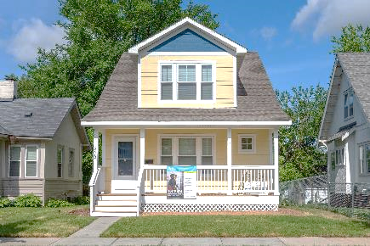
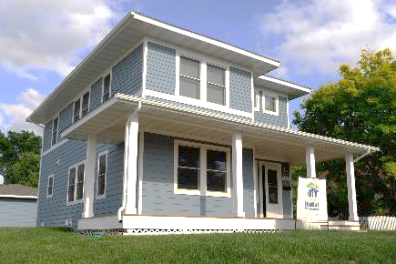
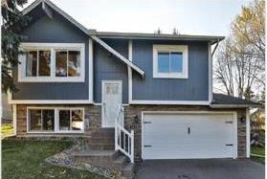
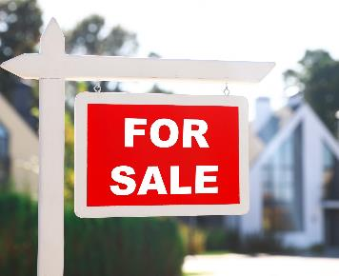
Habitat home choices
Traditional builds
Next Generation
Buy and rehab
Open market
Bucket 1: Infill and new construction
Bucket 2: Rehabs
Volunteer labor
Public funding with restrictions
Bucket 2: Habitat homeowner sells home back to Habitat to resell
New flooring, trim, paint and appliances by Habitat
Cost effective, time efficient
Bucket 3: Innovative partnerships with cities and counties and
investor-owned homes
Moderate rehab
Quick turnaround with subcontractors
Habitat never owns home
Bucket 5: Homebuyer purchase utilizing Habitat financing and programming
ReStore Home Outlets
All Habitat mortgages are provided by TCHFH Lending, Inc., a wholly-owned nonprofit mortgage lending subsidiary of Twin Cities Habitat for Humanity.
Notes:
Families partner to buy a home with us in a variety of ways [no need to get all the detail here for most donors, adjust as appropriate]
When we talk about Doing More, it’s grounded in this idea that we offer a variety of choices
Our goal this year is 129 closings total; 64 or 65 closings are the Habitat-developed; the other half are open market
We’re able to offer all these choices because of our mortgage partnership with Bremer
Launched partnership in the last strategic plan – Bremer buys our mortgages, below-market interest rate
Renewed this partnership in 2022;
We do have to adjust the interest rate periodically based on the market, Bremer continues to be committed to the below-market rate
We have really strong leadership and partnership with Bremer
Offer some detail as appropriate
Bucket 1 is new construction using volunteers
We won’t back away from these ‘traditional builds’
So critical to our work and community engagement
Bucket 2 is buybacks and rehabs using volunteer labor
Call it Next Generation because we the next family / generation gets to move in
Next Generation home finishes too – new flooring, trim, paint, etc. as needed
Bucket 3 is quick rehabs, don’t require much work, use sub contactor labor - portfolio acquisition (ABWK work)
Focus on first and second ring communities
We can make a cash offer and close quickly
Increases what we have for homebuyers
Keeps these properties out of the hands of investors/flippers
Ideally the homes would be turn-key, but it’s difficult to find that; we do some rehab work
Shifting our strategy this year to do even more of this approach
Bucket 5 Open Market- Habitat doesn’t own the home, applicant uses Habitat mortgage (Bucket 4 removed as of 2/13/23)

Slide 7

About families who buy with Habitat
$54,620
Average household income
Homebuyer professions include:
Bus driver
Educator
Office admin
Line worker
Hospital staff
Security officer
Data: July 2016 – June 2023
Notes:
People who buy homes with Habitat are typically working class – often families, but not exclusively
Share a few examples of job types – people who have stable income but it’s not enough to afford a home through a traditional lender
Covid really shined a new light on many “front line workers” – these careers are well represented among Habitat homeowners
Our income criteria varies by household size; for a household of 4, our income range is $42,000 to $89,600 (as of Nov 2022). See latest here https://home.tchabitat.org/homeownership-criteria
We’re really proud that consistently 80+% of our families are households of color
We’ll get into this a little bit more soon, but we’re glad that we have lots of racial diversity among our clients

Slide 8

Click icon to add picture
Outcomes of Habitat homeownership
91% feel better about kids’ future
77% feel safer now
41% visit the doctor less
92% of adults have gone or plan to go
back to school
Dramatic reductions in public assistance
99% attribute the positive changes
to Habitat
Notes:
As you know, where we live impacts so many parts of life – health, education, finances, etc.
Wilder Research conducted a Homeowner Impact Study in partnership with Habitat for Humanity of Minnesota. Wilder surveyed 400 Habitat homeowners across the state to understand the connection between Habitat homeownership and a family’s quality of life.
The Wilder study results prove what we’ve heard through family stories: Habitat homeownership boosts health and safety, provides a foundation for greater education outcomes, brings stability to a families’ economic situations, and enables families to be more engaged in their communities.
The best part—families attribute these positive changes in their lives to Habitat. Your support of our mission supports these incredible outcomes.
Public assistance details for those who ask
Before Food support: 57% Welfare 25% Medical 74% Rent 17%
After Food support: 27% Welfare 3% Medical 55% Rent 0%
More than twice as many families report no longer needing public assistance after buying their Habitat home. Habitat homeowners’ reduced reliance on public assistance saves Minnesota taxpayers $6.4M to $9.3M each year.

Slide 9


The housing crisis is mounting
There’s no easy housing math
Habitat homes lead to:
Greater success in school
1 in 4 Minnesotans spend more
than 30% of income on housing
Housings costs are rising while incomes remain stagnant
Minnesota’s racial gap in homeownership is the worst in the nation
More economic opportunity
Generational wealth building
Better health outcomes
Revitalized neighborhoods
Notes:
Homeownership is unaffordable and out of reach for too many families in our community.
One in four Minnesota households pays more than they can afford on housing and our state has fallen short on producing homes to meet growing demand
Housing is considered affordable when it is less than 30% of income. One-third of low-income families spend more than 50% of income on housing.
If people can limit their housing payment to <30% of income, they have money to fund their education, buy healthy food and good healthcare, pay for transportation, etc.
Rent and home prices are climbing, and wages are not keeping pace
Minnesota has one of the worst racial gaps in homeownership in the country. (more on next slides)
Your support can help fix the housing math.
We know from Wilder research and from countless homeowner stories that Habitat homeownership has an amazingly positive impact on health, education, and economic opportunity

Slide 10
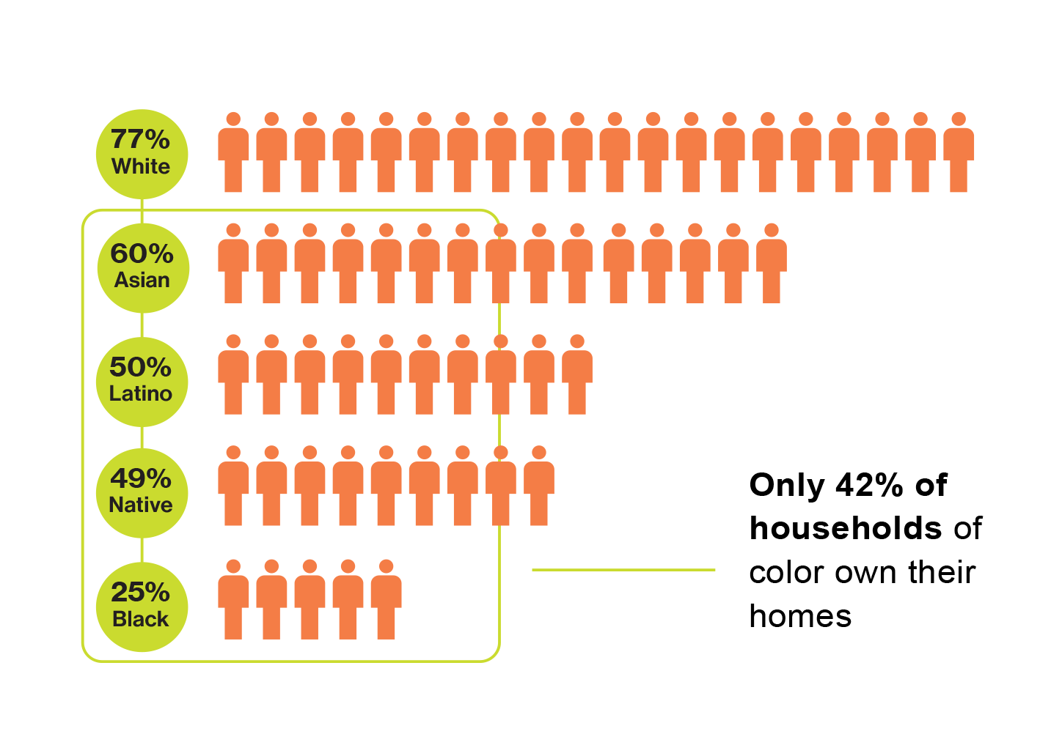
Minnesota’s
racial gap in homeownership
Nationally, the homeownership gap is 25%. Minnesota’s gap is much wider at 35%.
Data source:
Minnesota Housing Partnership, State of the State’s Housing 2021. Gabriela Norton.
Notes:
As a state we can boast that Minnesota has one of the highest homeownership rates in the country. But when you look at the data, you see that it’s really only true if you’re white
Minnesota has one of the widest racial gaps in homeownership of any state in the nation.
While 77% of White households own a home in Minnesota, this rate is 42% for households of color and just 25% for Black households. Black households continue to face the most systemic barriers to homeownership—even within Habitat’s programs.
While we’re proud that 80% of our clients have been families of color, we recognize that we need to make our programs work better for Black families.
We need to keep talking about this, but we also need to TAKE ACTION

Slide 11
Our disparities are rooted in racist policies
We need to be as intentional in removing our disparities as we were in creating them.
Redlining
Racial covenants
Interstate construction
Real estate practices
Tax code
Predatory lending
Ongoing bias
Notes:
These disparities have deep roots, including racial covenants, redlining by banks, and the expansion of our freeway system which segregated and destroyed Black neighborhoods. All these practices have led to the segregated neighborhoods we have today… and they meant that people of color haven’t reaped the long-term benefits of homeownership, including generational wealth building.
Knowing this history, we have a lot of work to do. We have to be as intentional about solving these disparities as we were about creating them.
Twin Cities Habitat for Humanity is building forward with intentionality. As we expand homeownership access, we’re also improving our programs for those who’ve historically been left behind. We’re adapting our program to work better for Black families—and we know that will have a ripple effect for everyone we serve.
[depending on donor questions/level of knowledge]: We’re seeing a lot of attention and urgency from our supporters – corporate partners are creating funds to support racial equity; there’s a lot of momentum here; Habitat is a leader in this space, we need to be at the table
[MORE CONTENT BELOW FOR YOUR REFERENCE, AS NEEDED]
Redlining – Starting in the 1930s, lenders used color-coded maps outlining the most and least desirable neighborhoods for lending. The “best neighborhoods” for lending were colored blue, and the “riskiest neighborhoods” for lending were colored red. This is where the term “redlining” came from (there were maps like these for the Twin Cities, too). Neighborhoods could be colored red simply because African Americans lived there or were moving into that area. These guidelines for discrimination remained in place for decades, effectively relegating African Americans to a few neighborhoods in each city with poorer loan prospects.
In cities across the U.S., including the Twin Cities, racial covenants were designed to block homes from being sold to people of color. Racial covenants appeared in the Twin Cities as early as 1910 and were in use through the mid-1950s.
The largest expansion of homeownership in our country’s history occurred following World War Two with the GI Bill. But Black veterans who fought for our country were largely excluded from the benefits of this expansion due to the widespread use of racial covenants and redlining.
Interstate construction, including I94 and 35W, systematically targets neighborhoods of color. In the case of I94, the highway was routed through the main street of a thriving Black neighborhood, Rondo. The construction of I94 displaced 1 in 8 African American families in St. Paul. Families were paid pennies on the dollar to have their homes destroyed. I94 also cut off North Minneapolis from the rest of the city.
Real Estate Practices are filled with racial bias. So-called “love letters” to sellers welcome race- and income-based discrimination. Bias in the appraisal process means homes sold by Black families are often under-appraised (on the flip side, studies have shown that Black homeowners get over-appraised values when it comes to tax appraisals, so Black homeowners pay more in property tax than they should).
Tax code – the mortgage interest deduction is, by far, the biggest housing subsidy in our country (about $30 billion a year in 2019). The MID gives a bigger deduction for bigger mortgages, so its benefits flow to higher-income earners, who are disproportionately White.
Predatory lending – While many discriminatory practices were meant to be halted with the 1968 Fair Housing Act, we know racism in housing continues. Communities of color were targeted with predatory lending in the early 2000s and were hit hardest when the bubble burst.
Ongoing discrimination – the Fair Housing Act lacks enforcement. Bias continues. We can’t solve decades/centuries of racism in housing with “race-blind” policies.

Slide 12


2022-2026
Strategic Plan
Notes:
Started the strategic planning process pre-covid.
With the start of the pandemic, we took an intentional pause to shift our focus on responding to the pressing needs and keeping families in their homes.
Came back to it, relaunched strategic planning process with intention and excitement
As an organization, we are building forward with intentionality – centering our work around those most historically impacted by housing discrimination, redlining, racial covenants, and systemic racial housing practices.

Slide 13
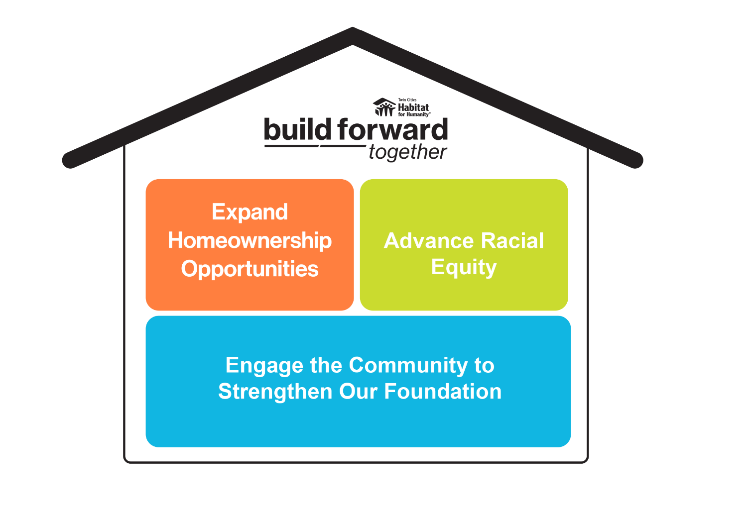
Notes:
Organizing our entire strategic plan around three themes:
Expand Homeownership
Increase homeownership production across the seven-county metro area through large-scale developments and innovative building strategies.
Go to reach a new height of 150 closings per year by 2026
Advance Racial Equity
Build forward with intention by centering our work around those most historically impacted by systemic housing practices.
Our focus is on Advancing Black Homeownership internally at Habitat and through policy/advocacy work
Engage the Community to Strengthen Our Foundation
Create new partnerships, deepening community engagement and feedback, and working side-by-side with neighbors to build a more vibrant Twin Cities.
Showing up in community differently – stepping back, listening to community, bringing our resources in line with the community’s needs
We want to be the best workplace ever – this is a key part of this theme
Financial responsibility

Slide 14

Expand Homeownership
Strategies
Key Innovations
Create homeownership opportunities
Scale building strategies
and sustainability
Stabilize and preserve
affordable homeownership
Major Developments – Harrison Townhomes,
The Heights (major news!)
Public partnerships – Roseville, Dakota County
Community Partners – Prior Lake, Chaska, Minnetonka
Notes:
Theme # 1 of the strategic plan: Expand homeownership
Creating homeownership opportunities, scaling building strategies, and sustainably stabilizing and preserving affordable homeownership.
Goal is to grow closings 20% overall through this plan
Exploring large-scale projects and partnerships with developers
Example: Example: Harrison Townhome development project: Twin Cities Habitat for Humanity partnered with City of Lakes Community Land Trust to develop 17 townhomes in the Harrison neighborhood in Minneapolis now through 2024. Harrison is a culturally, racially, and economically diverse community, and we are excited to bring affordable homeownership opportunities to the area. https://www.tchabitat.org/blog/affordable-townhomes-coming-to-Minneapolis
Hillcrest Golf Course site, now called The Heights – we would love to show up in that development with 100-200+ units
Want to be at the table when the time is right for these big developments
On the acquisition side, some key partnerships
Dakota county – we’re working with their public housing authority to convert single family rental homes to homeownership
Creating homeownership
Putting money into Dakota County to create more affordable rentals
In some cases, it’s freeing up a section 8 rental voucher
Since Feb. 2022, we’ve purchased 33 homes from the Dakota County CDA (Community Development Agency). This is about halfway through their portfolio they’re considering for this partnership
Hoping this could be replicable in other counties
City of Roseville
Sent a letter to property owners – if you’re considering selling your home, think about habitat
We’ve been shocked by the response; aimed for 3-4 homes, we’re already at 10+ homes
What we’re hearing – sellers love the option because they know it’ll remain affordable and will be a family home; for the sellers, it’s also a good option for them (no staging, cash offer, close on their timeline)
City is contributing some money into this - $ for down payment or for home updates
We’re working on replicating this in other cities
We now have an agreement with the City of Edina
Brooklyn Park and Brooklyn Center conversations
Apple Valley, Burnsville, and Eagan – indicated they’re interested
Both examples – look at existing housing stock and figure out how we can keep it affordable long term; big concern for cities

Slide 15
Advance Racial Equity
Strategies
Key Innovations
Close homeownership gaps to advance Black homeownership
Elevate equitable homeownership through policy and advocacy
Special Purpose Credit Program
Grassroots local
advocacy efforts
Notes:
Closing the racial gap in homeownership is the laser focus of this strategic plan
Advancing racial equity – everything we do is through this lens;
This is the focus of the strategic plan; urgency, needed, and Habitat is well-positioned;
Special purpose credit program (details on next slide)
Grassroots local advocacy efforts – The Heights, Minnetonka Mills
Minnetonka
Local advocacy efforts to educate neighbors about affordable housing, Habitat
Some feedback/concerns – traffic, home design, etc.
We heard feedback and we’re making modifications

Slide 16
Advance Racial Equity
Advancing Black Homeownership:
Special Purpose Credit Program
Cohort Approach to Financial Coaching
More Flexible Underwriting Criteria
Additional Financial Assistance
Notes:
Special Purpose Credit Program (SPCP)
Special purpose credit has been around for a long time; recently, government entities said it was okay to create a race-based program as long as it’s based on data that demonstrates people have been discriminated against
We’re creating a special purpose credit program that is designed to advance racial equity/advance Black homeownership (support Foundational Black Households) – focused on those who’ve been targets of housing discrimination for generations AND have experienced lower success rates within Habitat’s program
Key components:
Cohort model for financial coaching – peer to peer coaching sessions; more content and support
More flexible underwriting – noticed this as a barrier; found areas we could make more flexible to increase access for clients
Additional financial assistance – up to an additional $50,000 to use toward the saving requirement and/or for additional purchasing power
Clients need to have $6,300 in savings at the closing table; this can be a barrier for some, especially if they’re trying to pay off debt; they can use these resources toward that savings requirement
Can’t be used to pay off debt, but clients can shift these resources to fulfill the savings requirement, then use their savings to pay off debt
Launched to existing Habitat clients in fall 2022

Slide 17
Engage the community to strengthen our foundation
Strategies
Key Innovations
Cultivate meaningful partnerships
Build an inspiring organization where all thrive
Balance growth with financial and operational strength
$125M Bremer Bank partnership renewal (Home Loan Impact Fund)
New community partnerships including Black Men Teach and Pathways to Success
3rd ReStore location
Notes:
The foundation of that house graphic is the community
How we show up in the community
How we’re thinking about community partnerships
Bremer partnership
3rd ReStore

Slide 18
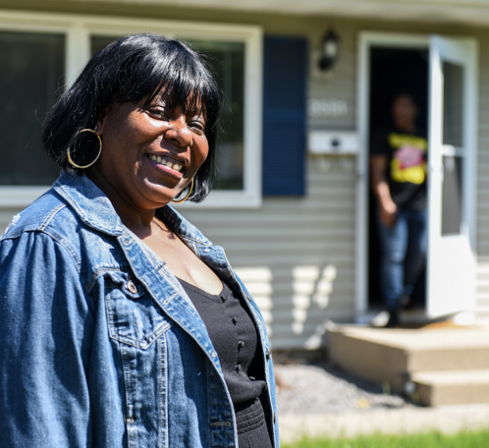
“I am just truly so grateful to Habitat for allowing me to go through the process and having them guide me.”
– Angela Gladney,
Habitat homeowner since 2023,
part of our new special
purpose credit program
Read more about Angela >
Notes:
Angela Gladney
Angela had a lifelong dream of owning a home. She worked toward it for years but fear got in the way. When she learned about Twin Cities Habitat’s Advancing Black Homeownership program, everything changed. Angela met peers who shared her fears—and she got all the support she needed to persevere and unlock her dream.

Slide 19
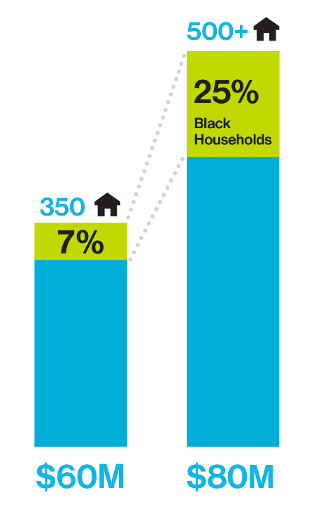
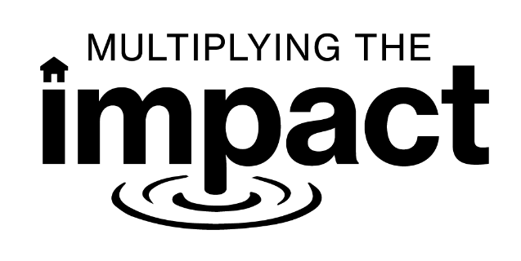

Served 7% Black households
Serve 25% Black households
Created 350 homes
Create 500+ homes
Raised $60+ million to
support the community
Raise $80 million to
support the community
Notes:
To fund all this amazing work, we’re in a comprehensive campaign to get these additional resources.
Love this graphic because it shows the growth AND shows our focus on advancing black homeownership
Where we were (looking back at Multiplying the Impact)
As the affordable housing crisis was mounting in 2016, we embarked on a journey to multiply our impact. We launched a sustainable mortgage partnership with Bremer Bank and rallied this generous community around Habitat’s mission.
The result? We reached our ambitious goal of doubling the number of families we serve—from 50 households per year to more than 100.
Celebrated when we raised $55M – all in, we raised more than $60M
Where we’re going (2022-2026)
Now, we’re building on this strong momentum to take our mission even further. With your support, Habitat is poised build forward and expand homeownership to a new height of creating an additional 150+ homes per year by 2026 and increasing the percent of Black households we serve toward 25% or more
We are building forward together, doing more and better to create an equitable Twin Cities region where all families have access to the transformational power of homeownership.
In order to do this, we need to raise $80M
Mackenzie Scott’s $13.5M is the lead gift to get us started; now we need to raise $66.5M
This is a four-year campaign (compared to a five-year MTI campaign)
We’ve been big and bold. We need our donors to be big and bold.
Don’t want to insult you by asking for too little.
Want to ask you for $XXX over X years.
Don’t need an answer today, want you to go home and talk with your family.
Our job is to follow up if we don’t hear from you

Slide 20
Every family deserves a
foundation to build a future on
and a place to call home
It is our vision to create an equitable Twin Cities region where all families have access to the transformational power of homeownership.
Notes:
Let’s build forward together to create a community where every family has access to the transformational power of home.

Slide 21


Serve 25% Black households
Create 500+ homes
Raise $80 million to
support the community
Your financial support is the key that unlocks our bold vision of a vibrant, equitable Twin Cities.
Notes:
Your financial support is the key that unlocks our bold vision of a vibrant, equitable Twin Cities.
Your support will help us raise $80M over the next four years to expand homeownership, tear down systemic barriers, and create a community where everyone has a place to call home.

Slide 22
Thank you!

Slide 23
Appendices

Slide 24
Celebrating our progress (2022)
Launched 2022-26 Strategic Plan
Renewed historic $125 million partnership with Bremer Bank
(Home Loan Impact Fund)
Launched Special Purpose Credit Program pilot to support existing families in our pipeline
January
March
May
August
October
December
Received transformational
$13.5 million gift from philanthropist MacKenzie Scott
Celebrated 500 closings as part
of the Home Loan Impact Fund
Partnered with the City of Lakes Community Land Trust to develop 17 townhomes in the Harrison Neighborhood
Notes:
At Habitat we're excited to share the work that we are doing in community to achieve our strategic plan goals and objectives. Follow our work in action.

Slide 25
Celebrating our progress (2023)
Announced as host of 2024 Jimmy & Rosalynn Carter Work Project! This event will bring thousands of volunteers to the Twin Cities in fall 2024 to build homes at The Heights.
Awarded $1 Million from Fannie Mae to develop regional approach to Advancing Black Homeownership
Hosted Town Hall to share progress on the Build Forward Together plan, including work to expand homeownership, advance racial equity, and engage the community to strengthen our foundation
Launched Pathways to Success partnership with Minneapolis Public Housing Authority and Twin Cities R!SE
January
February
March
April
June
Summer
October
Welcomed six new board members to help guide this bold strategic plan
Announced partnership at The Heights redevelopment, including creating up to 150 Habitat homeownership opportunities
Sponsored and participated in several community events, including Live Your Healthy Lyfe, Selby Jazz Fest, and Open Streets.
Notes:
At Habitat we're excited to share the work that we are doing in community to achieve our strategic plan goals and objectives. Follow our work in action.

Slide 26
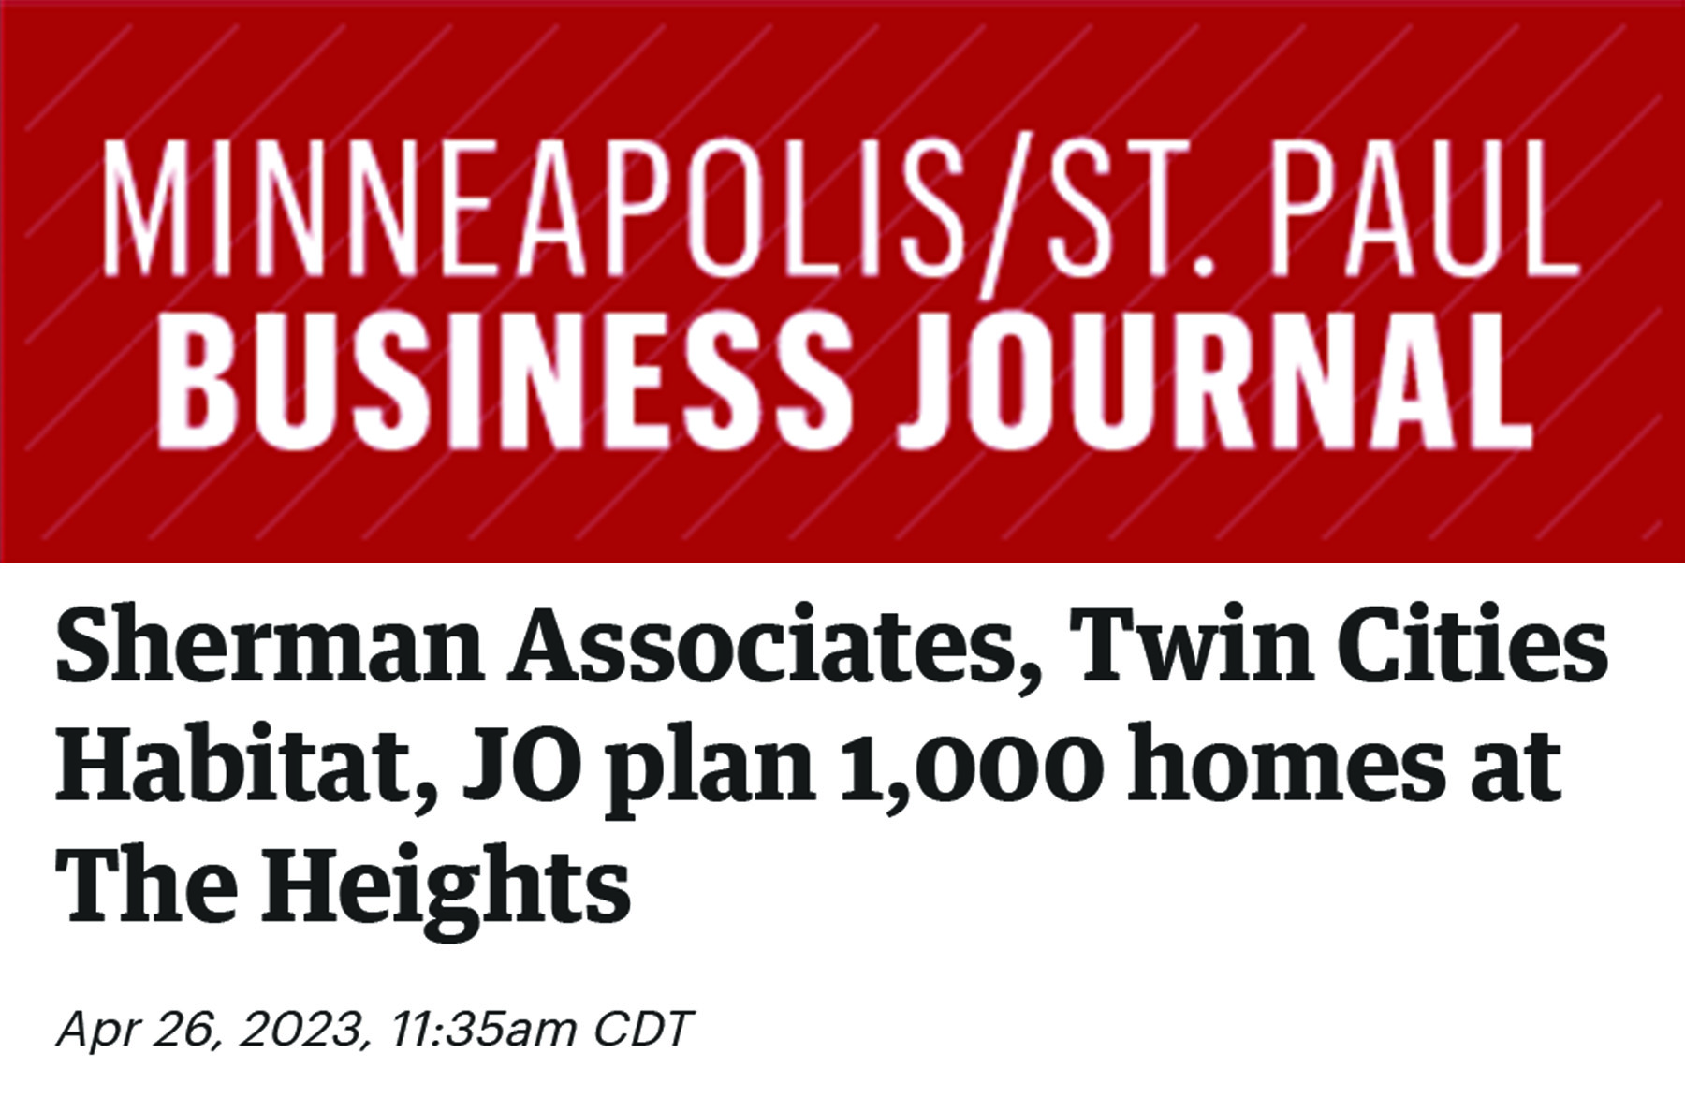
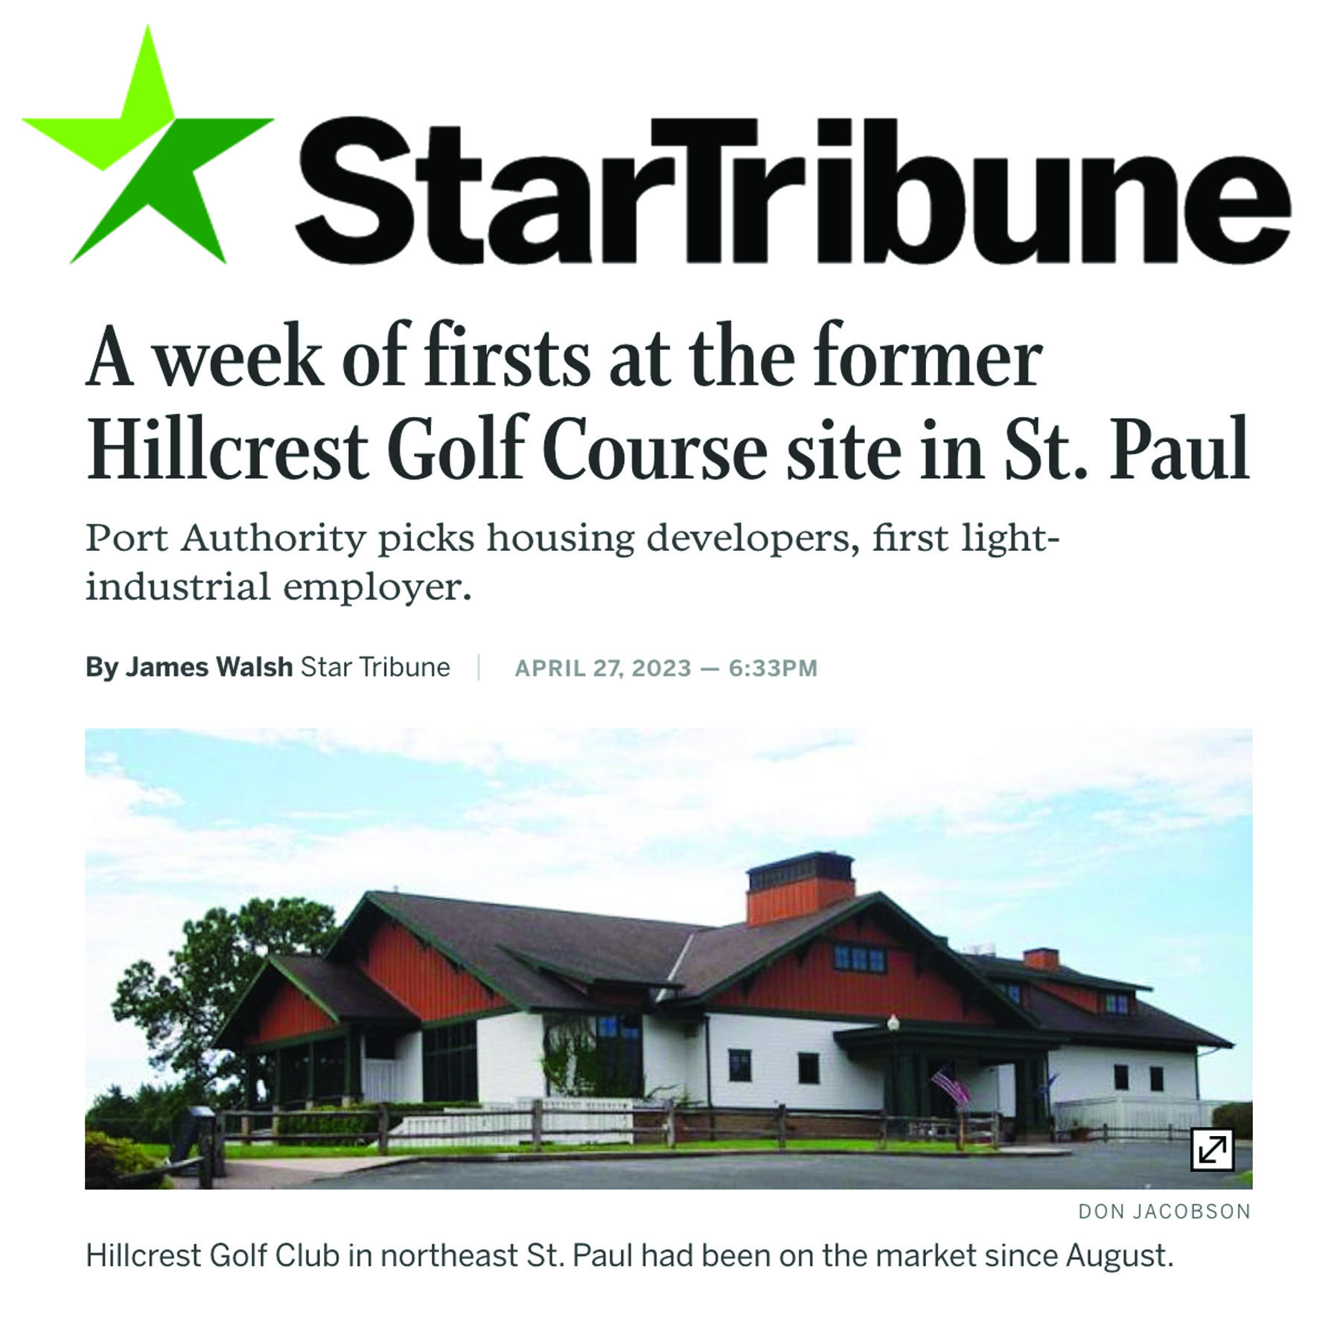
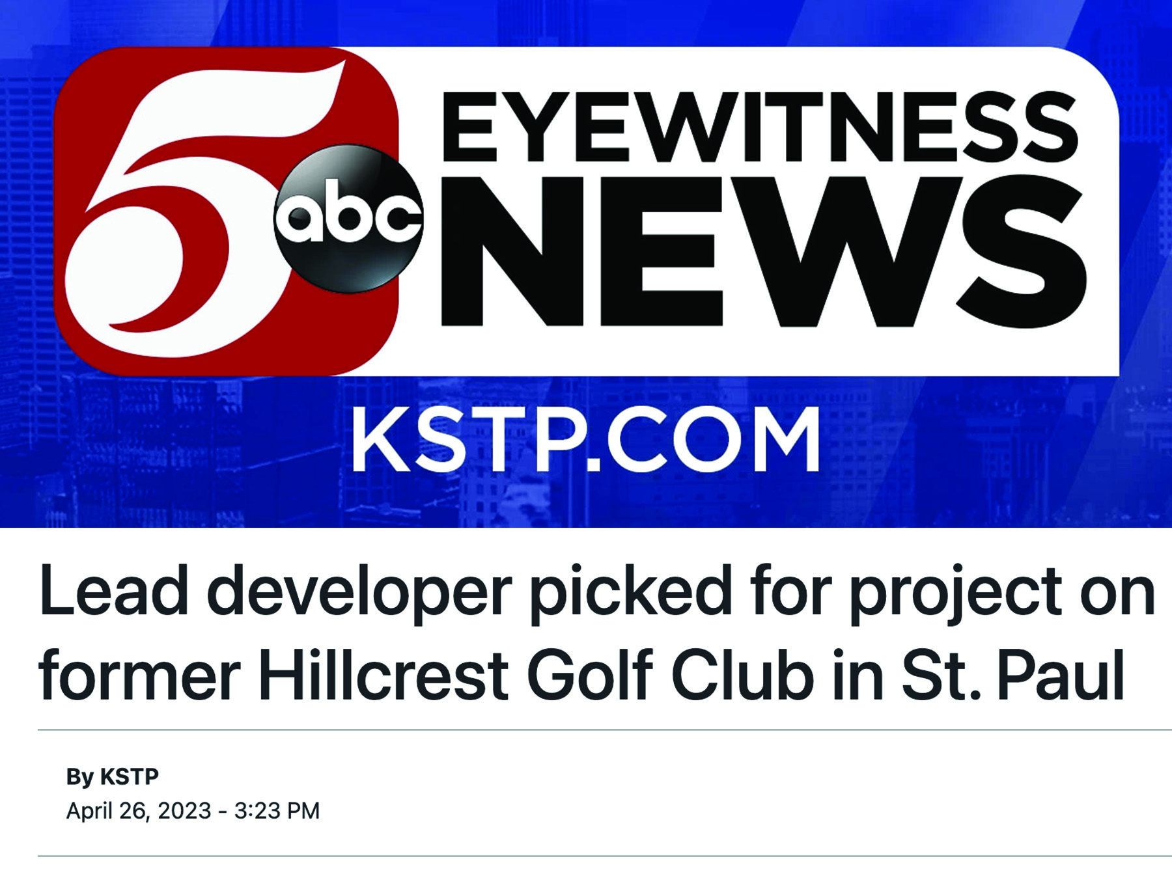
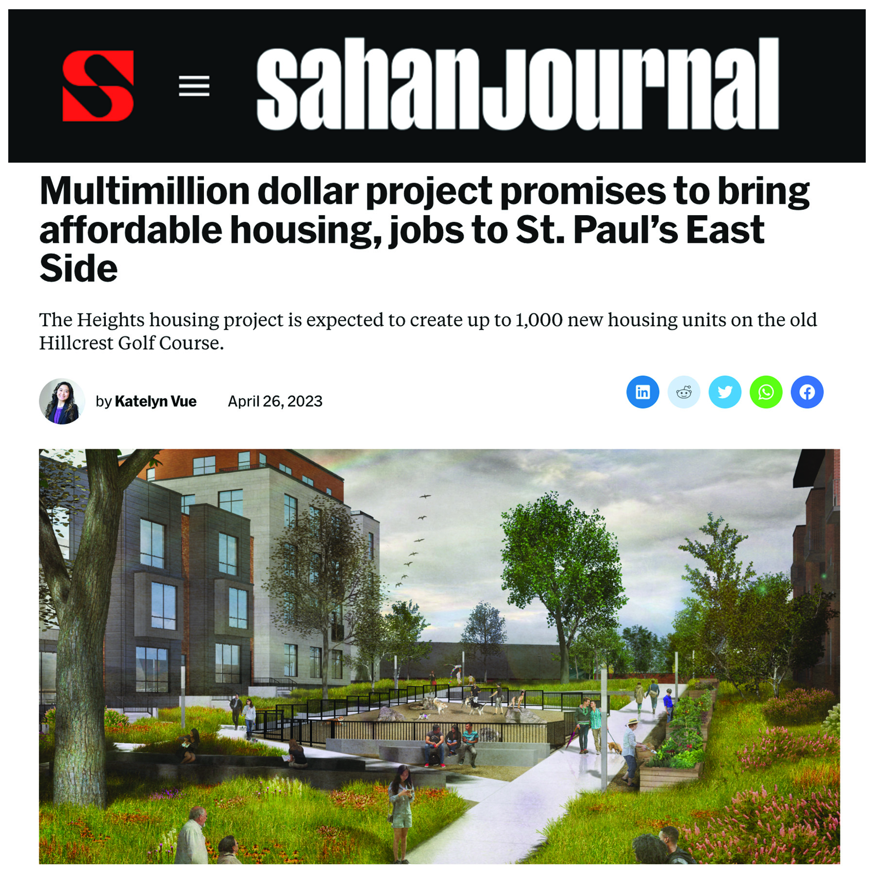

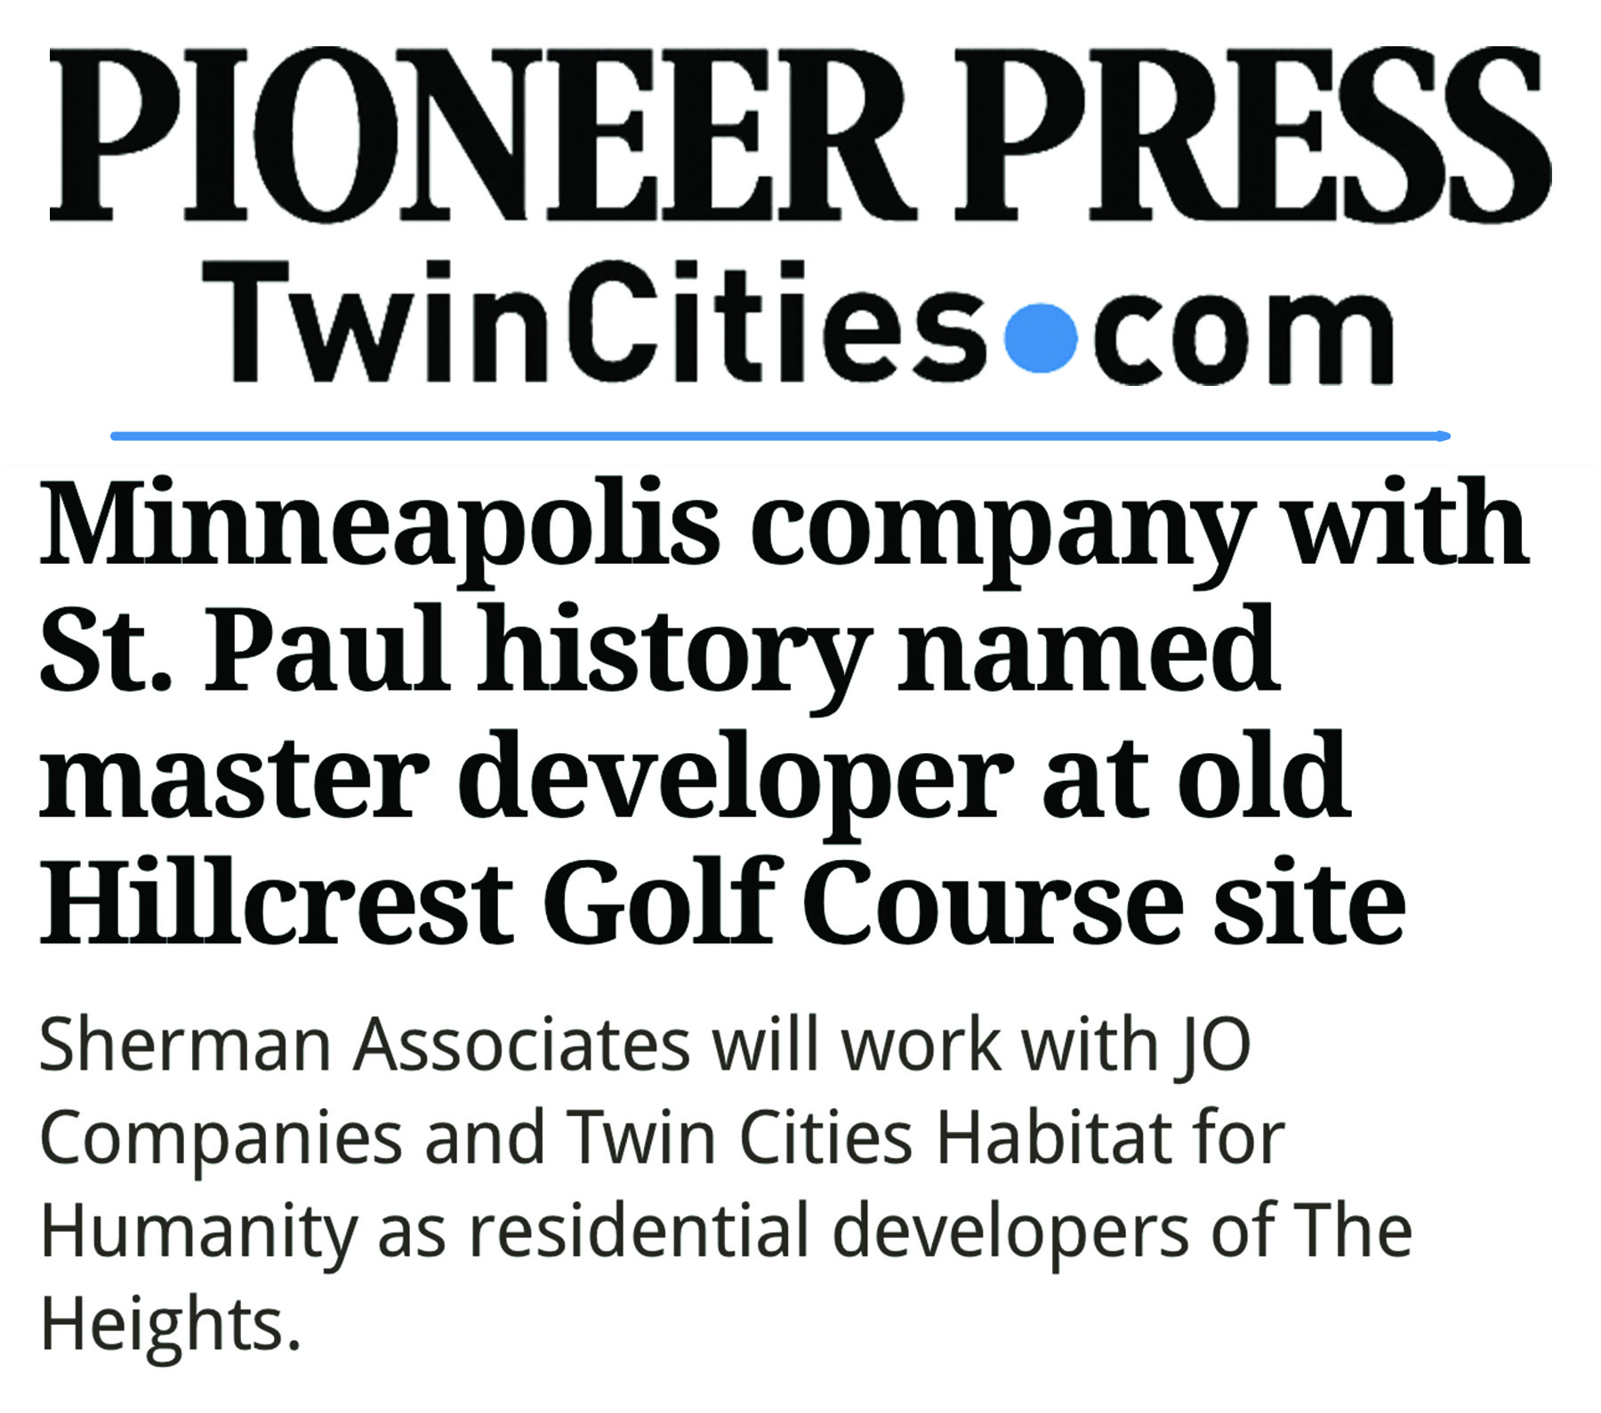
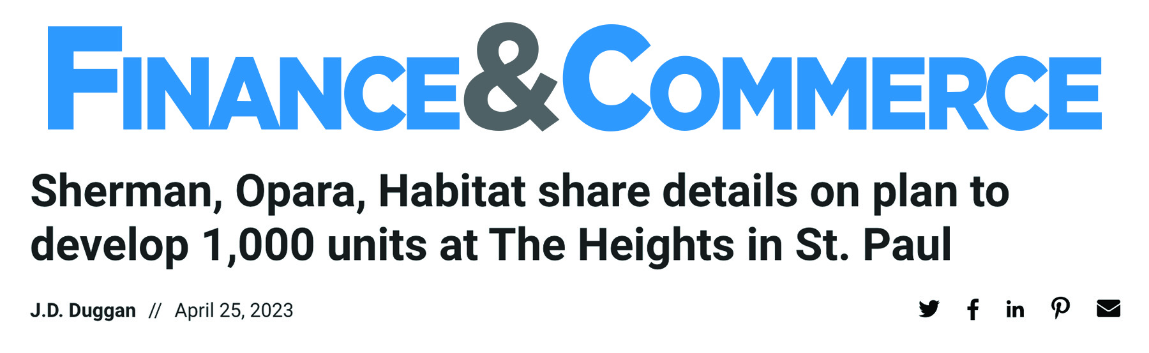

Slide 27
Habitat home choices
Traditional builds
Next Generation
Buy and rehab
Open market
ReStore Home Outlets
All Habitat mortgages are provided by TCHFH Lending, Inc., a wholly-owned nonprofit mortgage lending subsidiary of Twin Cities Habitat for Humanity.
Notes:
ALT VERSION – less detail
Families partner to buy a home with us in a variety of ways [no need to get all the detail here for most donors, adjust as appropriate]
When we talk about Doing More, it’s grounded in this idea that we offer a variety of choices
Our goal this year is 129 closings total; 64 or 65 closings are the Habitat-developed; the other half are open market
We’re able to offer all these choices because of our mortgage partnership with Bremer
Launched partnership in the last strategic plan – Bremer buys our mortgages, below-market interest rate
Renewed this partnership in 2022;
We do have to adjust the interest rate periodically based on the market, Bremer continues to be committed to the below-market rate
We have really strong leadership and partnership with Bremer
Offer some detail as appropriate
Bucket 1 is new construction using volunteers
We won’t back away from these ‘traditional builds’
So critical to our work and community engagement
Bucket 2 is buybacks and rehabs using volunteer labor
Call it Next Generation because we the next family / generation gets to move in
Next Generation home finishes too – new flooring, trim, paint, etc. as needed
Bucket 3 is quick rehabs, don’t require much work, use sub contactor labor - portfolio acquisition (ABWK work)
Focus on first and second ring communities
We can make a cash offer and close quickly
Increases what we have for homebuyers
Keeps these properties out of the hands of investors/flippers
Ideally the homes would be turn-key, but it’s difficult to find that; we do some rehab work
Shifting our strategy this year to do even more of this approach
Bucket 5 Open Market- Habitat doesn’t own the home, applicant uses Habitat mortgage

